Slide 1
Society of theMinds

Slide 2
What is a human mind and how does it work?
How do we recognize objects/scenes?
How do we use words and languages?
How do we achieve goals?
Very importantly-How do we learn?
How does common sense work?

Slide 3
Ants
Individually simple creatures but collectively perform complex tasks
How do they communicate?
How do they organize themselves?
How do they find the shortest route?

Slide 4
Agents Any part or process of Brain that by itself is simple enough to understand Any part or process of Brain that by itself is simple enough to understand Agents constitute the building blocks of the mind Agents constitute the building blocks of the mind In society of mind, mental activity reduces to turning individual agents on and off In society of mind, mental activity reduces to turning individual agents on and off

Slide 5
Agency Society of simple agents Society of simple agents Can perform functions more complex than any single agent could Can perform functions more complex than any single agent could Complicated behavior is the result of the interaction between groups of agents Complicated behavior is the result of the interaction between groups of agents

Slide 6
K-lines Turns on a particular set of agents Turns on a particular set of agents Activating a K-line can cause a cacade of effects in the mind Activating a K-line can cause a cacade of effects in the mind Reactivates the previous mental state based on the similarities between current situation and the situation previously encountered Reactivates the previous mental state based on the similarities between current situation and the situation previously encountered Causes to enter particular remembered configuration of agents Causes to enter particular remembered configuration of agents

Slide 7
Classes of K-lines Nemes are concerned with the representing aspects of the world Nemes are concerned with the representing aspects of the world Nomes are concerned with controlling how the representations are manipulated. Nomes are concerned with controlling how the representations are manipulated.

Slide 8
Nemes produced by learning from experience produced by learning from experience Polynemes invoke partial states within multiple agencies Polynemes invoke partial states within multiple agencies polynemes supports that meaning can be better expressed across multiple representations polynemes supports that meaning can be better expressed across multiple representations

Slide 9
K-lines. K-lines are the most common agent in the Society of Mind theory. The purpose of a K-line is simply to turn on a particular set of agents, and because agents have many interconnections, activating a K-line can cause a cascade of effects within a mind. Many K-lines are formed by 'chunking' the net effects of a problem solving episode, so that the next time the system faces a similar problem, it not only has the previous solution as a starting point, but also the experience of deriving that solution, which includes memories of false starts, unexpected discoveries, and other lessons from the previous experience that aren't captured by the final solution alone. Thus K-lines cause a Society of Mind to enter a particular remembered configuration of agents, one that formed a useful society in the past. K-lines are a simple but powerful mechanism for disposing a mind towards engaging relevant kinds of problem solving strategies, forms of knowledge, types of goals, memories of particular experiences, and the other mental resources that might help a system solve a problem

Slide 10
Nomes and Nemes. Minsky also uses K-lines in a somewhat different way, as the basis for a more structured or computer-like model of how information is represented and processed in a Society of Mind. He introduces two general classes of K-lines he calls 'nemes' and 'nomes', which are analogous to the data and control lines in the design of a computer. Nemes are concerned with representing aspects of the world, and nomes are concerned with controlling how those representations are processed and manipulated.

Slide 11
.
Nomes. Nomes control how representations are manipulated. Minsky gives examples of a few types of nomes, including isonomes, pronomes, and paranomes.
Isonomes signal to different agencies to perform the same uniform type of cognitive operation. For example, they may cause a set of agencies to save their current state to short-term memory and load in a different state, or cause them to begin training a new long-term K-line to reproduce the current state, or cause them to imagine the consequences of taking a certain action.
Pronomes are isonomes that control the use of short-term memory representations. A pronome is often associated with a specific 'role' in a larger situation or event, such as the actor who takes an action, or the location an event occurs. Some pronomes connect to very restricted types of short-term memories that can store only very specific types of knowledge, for example, places, shapes, or paths. Other pronomes may be much more general-purpose and influential, reaching most of the agencies of the brain. Minsky calls these 'IT' pronomes, and they connect to a great many representations that together can describe virtually anything. There may be only just a few of these 'IT' pronomes, because of the great many connections required to implement them.
Paranomes are sets of pronomes linked to each other so that assignments or changes made by one pronome to some representation produce corresponding assignments or changes by the other pronomes to related representations. Minsky introduces the concept of a paranome to describe how knowledge represented in different ways could nonetheless be related and treated together in a somewhat uniform manner. For example, a 'location' paranome might be connected to location pronomes attached to two different representations of spatial location, one in terms of an egocentric or 'body-centered' coordinate system, and the other in terms of an external or 'third-person' coordinate system. Using paranomes, one can coordinate the use of these multiple representations

Slide 12
How can we combine agents to build larger agencies?
Minsky gives several examples in the Society of Mind of how one might combine primitive agents into larger agencies that can do more complex things. Several of these examples are concerned with how larger representational systems might be built from simpler agents, and in particular, he describes how several types of frames might be built from simple elements like pronomes and recognizer-agents.
Frames. Frames are a form of knowledge representation concerned with representing a thing and all the other things or properties that relate to it in certain particular ways, which are attached to the 'slots' of the frame. Minsky describes how simple frames may be built from sets of pronomes that control the attachments to the slots of the frame. These pronomes are bound together so that when the frame is invoked, those pronomes cause their associated representations to invoke partial descriptions of aspects of the thing being described.
Frame-arrays. We can describe a thing richly by using not just one frame, but rather a collection of frames where each frame describes the thing from some particular perspective or point of view. Frame-arrays are collections of frames that have slots or pronomes in common. Minsky gives the example of representing the appearance of a cube from multiple different viewpoints, where each of those viewpoints is described with its own frame, but whose common parts (e.g. the six sides of the cube) are linked across different frames. The reason for sharing slots is that when one frame description is inadequate for solving some problem or representing some situation, it is easy to switch to one of the other frames, because some of their slots are already attached to relevant information. The shared slots of frame-arrays are the ancestors of paranomes.
Transframes. Transframes are a central form of knowledge representation in the Society of Mind theory. Transframes represent events and all of the entities that were involved with or related to the event. They may have slots for representing the origin and destination of a change (the before and after states), who or what caused the event, the motivation behind the event or the goal it is intended to achieve (if there was indeed an intention), what objects are affected and how, when it occurred, what tools or objects were involved in producing the change, and other important aspects of the event. Because so much of ordinary life concerns the relationship between events of various types, the transframe representation is central to everyday thinking.
Other types of frames. In addition to transframes, Minsky describes several other types of frames, including story-frames that represent structured collections of related events, and picture-frames that represent the spatial layout of objects within scenes. Presumably these are only a few of the many types of frames that are required to represent and organize the world as well as cognitive processes themselves.

Slide 13
How problems can be solved?
How can agents solve problems?
While Minsky argues that there no single method that societies of agents use to solve problems, he does suggest several ways one might build or organize problem solving agencies.
Difference-Engines. What does it mean to 'solve' a problem? Solving a problem can be regarded as reducing or eliminating the important differences between the current state and some desired goal state. Minsky proposes a simple machine called a difference-engine that embodies this problem solving strategy. Difference-engines operate by recognizing differences between the current state and the desired state, and acting to reduce each difference by invoking K-lines that turn on suitable solution methods. The difference-engine idea is based on Newell and Simon's early 'GPS' problem solver [11]. Minsky elevates the GPS idea to a central principle, and one might interpret Minsky as suggesting that we view the mind as a society of such difference-reducing machines that populate the mind at every level. But ultimately, there is no single mechanism for building difference-engines, because there is no single way to compare different representations.
Censors and Suppressors. No method of problem solving or reasoning will always work, especially when it comes to ordinary, commonsense reasoning. Thus Minsky proposes that in addition to knowledge about problem solving methods themselves, we also have much knowledge about how to avoid the most common bugs and pitfalls with those methods. He calls this type of knowledge negative expertise [12]. In the Society of Mind he describes this knowledge as embodied in form of censor and suppressor agents. Censors suppress the mental activity that precedes unproductive or dangerous actions, and suppressors suppress those unproductive or dangerous actions themselves. Minsky suggests that such negative expertise could even form the bulk of what we know, yet remain invisible because knowledge about what not to do does not directly manifest itself. Further, he suggests that there is an intimate connection between humor and such negative expertise; when we laugh at a joke, we may be learning about a particular type of problem or pitfall with ordinary common sense reasoning! Minsky discusses these ideas extensively in [13].

Slide 14
Communication
K-lines. The simplest method of communication is for an agent to just arouse some other sets of agents. An agent can turn on a polyneme to arouse agents that think about some particular object, event, or situation; or it may turn on micronemes that cause other agents to think about some general context; and so forth. For this type of communication it is not necessary for the sender agent itself to know how to express an idea in terms of the representations available to the recipient agent. Rather, that information is stored in the intervening K-lines that result from successful past communications.
Connection lines. Many agents are not directly connected to each other but rather communicate via 'connection lines', buses or bundles of wires that transmit signals to other agents attached to the bus. These wires can be thought of as simple agents in themselves, and while they are initially meaningless, over time the individual wires begin to take on local significance, that is, they come to acquire dependable and repeatable 'meanings'. Agents communicate over these connection lines by connecting K-lines to random subsets of the bus wires. This strategy of random connection, first invented by Calvin Mooers, allows a relatively small bus to simultaneously represent a great many independent symbols or states with a low probability of collision between them. On the other side, agents can observe these connection lines to begin to recognize patterns and signals in the wires. Just as the senders do not initially know what the wires mean, neither do the recipients, and so the agents that connect to the bus need to make guesses and hypotheses to come to understand their meanings.
Internal language. For agencies that need to communicate more complex, structured descriptions of things, as in a system of linked frames, Minsky proposes a more elaborate communication mechanism in [14], modeled after his 're-duplication' theory of how people communicate with each other through natural language. If one agent wishes to convey a complex idea to another, it attempts to re-construct the idea expressed in its own representational system by a sequence of frame retrieval and instantiation operations. For each of these operations there is an associated 'grammar-tactic' that produces words or signals that are sent to the recipient agent. 'Inverse-grammer-tactics' in the recipient agent perform analogous construction operations, but now in terms of the different representations used by the recipient agent. This method of communication requires that the two communicating agents agree well enough on the meanings of these 'words' or representation-construction operations.
Paranomes. Perhaps the most common method of communication in the Society of Mind is actually for there to be no active communication at all. Instead, agents often find that the information they need is already available when they need it. This is the result of the use of paranomes. As described earlier, when one pronome of a paranome produces a particular state in terms of one representation, the other pronomes simultaneously update their representations so that they enter corresponding states. Here, communication happens not by sending explicit messages, but rather at all times different agencies are separately looking at the same property, object, event, situation, or other type of thing from their own unique perspective, and any changes to one representation are immediately reflected in the other corresponding representations.
Ambiguity. While this is not so much a communication mechanism in and of itself, an important consideration in how agents communicate in a Society of Mind is that precise communication may be unnecessary, and in fact, may be impossible, between different agents.

Slide 15
Protospecialists. In an infant mind, the first functional large-scale agencies are protospecialists —
highly evolved agencies that produce behaviors providing initial solutions to problems like locomotion,
obtaining food and water, staying warm, defending yourself from predators, and so forth.
While these initial protospecialists are fairly unskilled, over time their performance may improve by
exploiting agencies that develop later.
Predestined learning. Related to the notion of a protospecialist is the idea that complex behaviors need not be fully
pre-specified nor fully learned, and instead can result from a mixture of more partial such influences.
Minsky suggests many of the kinds of abilities that are shared among all people, e.g. language or walking, are the result of predestined learning,
learning that develops under just enough internal and external constraints that the end result is more or less guaranteed.
Types of learning. Minsky describes several important forms of learning: accumulating,
uniframing, transframing, and reformulating. Accumulating is the simplest form of learning, where you simply remember
each example or experience as a separate case. Uniframing amounts to finding a general description that subsumes multiple examples. Transframing is forming an analogy or some other form of bridge between two
representations.
Reformulationamounts not to acquiring fundamentally new knowledge per se, but finding new ways to describe existing knowledge.
Learning from attachment figures. A very important type of learning is concerned with the question of how we learn our goals in the first place.
This form of learning is not so much about how to acquire the specific representations and processes needed to achieve some goal, but rather how to learn when a particular goal should be adopted and how it should be
prioritized relative to our other goals. Minsky suggests that we learn many of our goals through interactions with our 'attachment figures', special people in our lives, such as our parents, whom we respect. Praise and
censure from our attachment figures results in 'goal learning' as opposed to 'skill learning'; when we are praised by an attachment figure for solving some problem, we choose to seek out more such problems in the future,
and when we are censured by them, we choose to avoid such problems.
Learning mental managers. As a mind grows up, it acquires not only increasingly sophisticated models of its environment, but also builds increasingly sophisticated
cognitive processes for making use of those models—knowledge about when and how to use knowledge. As we accumulate our mental societies of agents, we build 'mental managers' to regulate them, processes for
delegating, controlling, repairing, and selecting more specific knowledge and problem solving techniques. This idea led Minsky to coin Papert's Principle :
Some of the most crucial steps in mental growth are based not simply on acquiring new skills, but on acquiring new administrative ways to use what one already knows. [2, Section 10.4]
These sorts of managerial hierarchies often make use of a conflict resolution strategy that Minsky calls the Principle of Non-Compromise. When two agents disagree, rather than employing some
simple method such as averaging or weighting, mental managers can instead use the conflict as a sign that they need to reformulate the problem by bringing in some third agent with a different perspective, one that can
see the problem and its potential solution with greater clarity. This goes hand in hand with the idea of distributing authority in a mind; the job of the manager is not so much to directly resolve the conflict, but rather to
find other points of view that cause the conflict simply to disappear from the new vantage point.
Developmental stages. Ultimately, nothing as complex as a mind can be built in a single stage of construction. This idea was on Minsky's mind from his earliest thoughts about societies of mind:
The proper form of a "the

Slide 16
One attempt to build something like a Society of Mind programming language is Brooks's Behavior Language [21]. Brooks's early robots had control structures composed of networks of simple computational elements, and to make it easier to program these robots he developed the Behavior Language, which on the surface resembles Lisp, but compiles programs into finite state automata which are then run directly. A more recent attempt to build such a language is Hearn's K-line Language, which uses K-lines as a primitive element and builds on his prior work, a behavior system for a simulated robot that used polynemes, pronomes, picture-frames, transframes, and other simple elements from the Society of Mind to direct the actions of the robot

Slide 17
The major difficulty with such approaches is that it has been hard to find good 'higher level' abstractions for agencies, ones that make it easy to describe agent systems that use higher level representations and methods for problem solving, and can map these abstractions to simple elements like K-lines and recognizer-agents. It remains an open question whether a programming language at the level of the simplest computational elements will ultimately be the language in which developers program, or more like a 'machine language' to which some even higher level programming language compiles down to. In either case, however, it is clear that developing such a language is a useful endeavor.

Slide 18
The theory itself has not stopped developing. The Society of Mind represents a snapshot in time of Minsky's ideas, and he will soon publish a sequel, The Emotion Machine [9], that will describe the many ideas that Minsky has had about the mind since the late 1980s. However, we predict that The Society of Mind will still be read decades from now, when other AI books have long become outdated, and that it will continue to inspire and challenge future generations. And in time, we expect that the fundamental hypothesis of the book will be finally proved

Slide 19
“Weak AI” Vs “Strong AI”

Slide 20
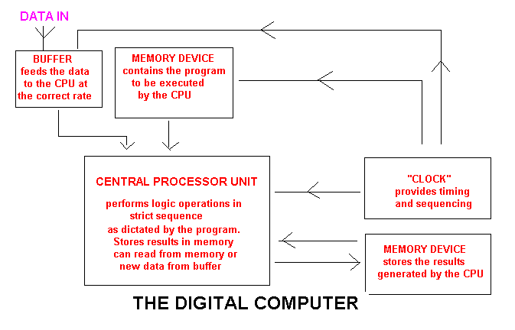

Slide 21
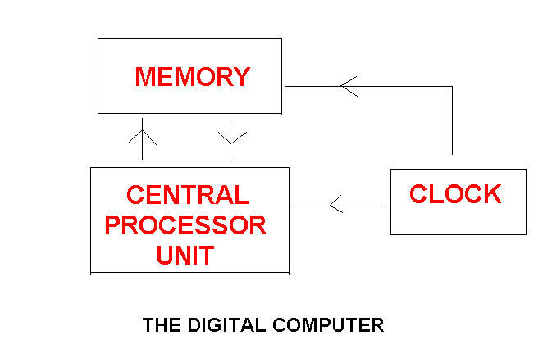
Slide 25

Slide 22
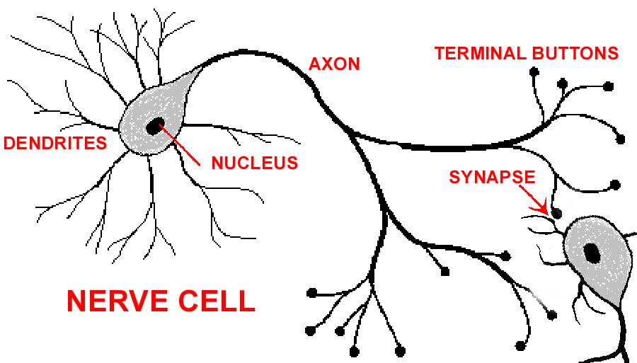

Slide 23
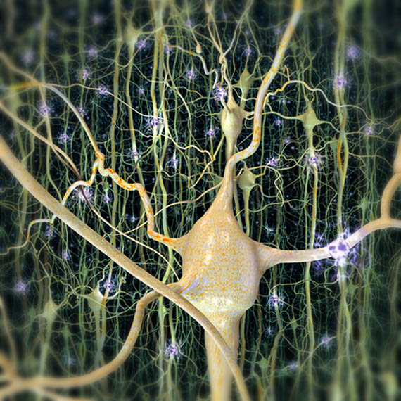

Slide 24
Slide 28
COMPUTER
Stores most of its information in devices external to the CPU
Performs tasks sequentially, and transfers results back to memory
Performs relatively few tasks simultaneously
Relies on a central clock to synchronize and sequence its operations
Performs precise instructions which have been given in advance
Performs individual operations in a time scale of nanoseconds
BRAIN
The CPU and the memory are the same thing: there is no memory storage external to the CPU
Performs enormous numbers of tasks simultaneously
Asynchronous: no central clock
No separate instructions (program): the instructions are written-in to the architecture of the system and are subject to continuous reappraisal
Individual operations take place many millions of times more slowly

Slide 25
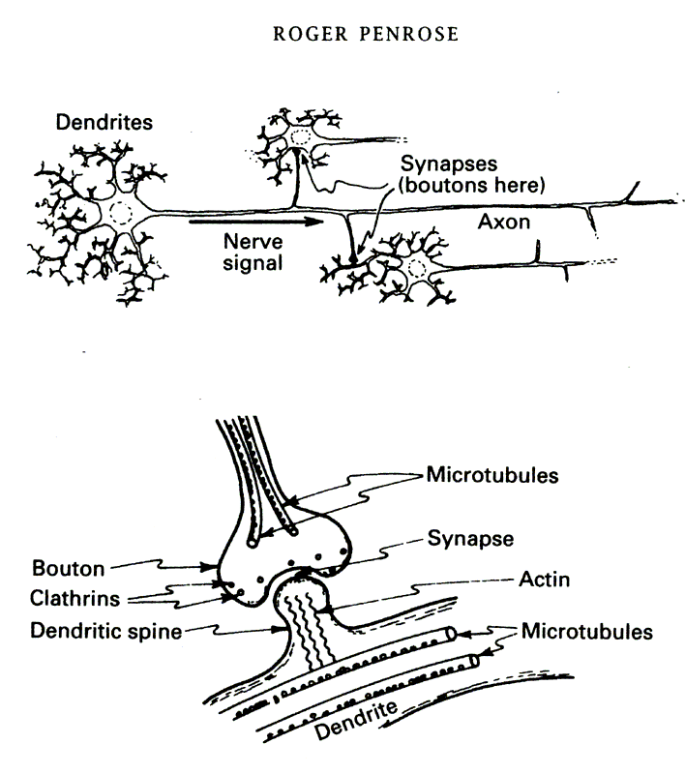
Slide 29

Slide 26
Quantum Computing
Roger Penrose &Stuart Hameroff microtubule perform an extreme form of “quantum computing”
Penrose suggests that this complicates the concept of recreatingneurons
He also hyphothezes that the brains quantum computing is responsible for consciousness and systems biological or otherwise cannot be conscious without quantum computing
Singularity?

Slide 27
Gödel, Escher, Bach: an Eternal Golden Braid
Douglas R. Hofstadter
Basic Books Inc., N.Y. (1979)
‘… an “I” comes about… via a kind of vortex whereby patterns in a brain mirror the brain’s mirroring of the world, and eventually mirror themselves, whereupon the vortex of “I” becomes a real, causal entity.’

Slide 28
There are many big ideas in GEB but perhaps the biggest is the notion of recursion. What happens when things refer to themselves? Hofstadter explores this idea in many ways throughout the book - including the structure of the book itself and the pictures. Three of the ways he explores it are in the logic and formal systems of Godel, the artwork of Escher and the music of Bach. Elements of computer science such as Call stacks are also discussed in Gödel, Escher, Bach, as one dialogue describes the adventures of Achilles and the Tortoise as they make use of "pushing potion" and "popping tonic" involving entering and leaving different layers of reality. Subsequent sections discuss the basic tenets of logic, self-referring statements, ("typeless") systems, and even programming. Hofstadter further creates BlooP and FlooP, two simple programming languages, to illustrate his point.
Puzzles[edit]

Slide 29
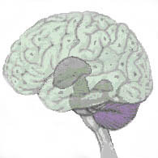
Slide 33
Beyond the Human Era:
Speculations on the Evolution of Mind

Slide 30
Slide 35
Beyond the Human Era:
Speculations on the Evolution of Mind

